Slide 1
Case Study: Trajectory Data Analysis
May Fu, Kylie Greenwald, Grace Liu, Elise Zhang

Slide 2
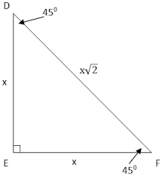
Task 1: Identifying the Hubs
Preprocessing Algorithm
Matrix Initialization: A matrix is initialized based on the neighborhood radius inputted r_n, as well as the minimum/maximum values in the data set. The neighborhood radius determines the grid size for each matrix cell, namely (r_n * √2) by (r_n * √2). For the geolife-cars.csv, the data has a minimum of -103.532808 and a maximum of 96.237468. Thus, the matrix bound can be set as 105 kilometers. There are ~ 1 ⁄ (r_n * √2) matrix cells per 1 kilometer, which yields a 105 * [1 ⁄ (r_n * √2)] * 2 square matrix.
Matrix Population: A for-loop iterates through all of the points in the given data set and maps each point to their respective matrix cell. Each cell represents a grid in the 2D plane, based on r_n as described above. For each point, the count in the respective matrix cell is incremented by 1.
Runtime: O(n) where n is the number of points in P. This algorithm loops through all of the
points in order to increment the corresponding matrix cell count by 1.
r_n * √2
r_n
r_n

Slide 3
Task 1: Identifying the Hubs
Density Algorithm
Algorithm Explanation: This algorithm takes a point as input and utilizes both the neighborhood radius r_n and the preprocessed matrix, which are declared as attributes for the class Hubs. As mentioned in the previous slide, each kilometer is represented by ~ 1 ⁄ (r_n * √2) matrix cells. Thus, both the x- and y-coordinates of each point are multiplied by that factor. Additionally, (factor * 105 - 1) is added to both coordinates to avoid indexing the matrix with negative values. Finally, the count at the matrix cell indexed by the translated coordinates is returned.
Reason for choosing algorithm:
allows for the density of a point to be quickly returned
converts a given point into its matrix-specific coordinates and returns the value accessed by indexing the matrix at those coordinates
Parameters and explanation:
takes the point (point) directly as a parameter
density() function (method in the class Hubs) inherits r_n and matrix attributes
point and r_n variables are used to translate to the correct matrix indices and the matrix itself is used to provide the density at those indices

Slide 4
Task 1: Identifying the Hubs
Density Algorithm (continued)
Density calculation w/ example: The density() function works by translating the given point into its matrix indices and then returning the value at that matrix cell.
Function call: density([-8.84, 3.49]) and r_n is declared as 0.25 km
Translation constants:
factor = 1/(self.r_n * √2) = 1/(0.25 * √2)
bound = math.ceil(factor * 105) = 297
Calculate matrix indices:
x = math.floor(-8.84 * factor) + 297 - 1 = 270
y = math.floor(3.49 * factor) + 297 - 1 = 305
Return:
matrix[270][305]
Runtime: O(1). This algorithm merely consists of arithmetic operations to calculate the correct matrix coordinates from the given point in order to return the count at the respective matrix cell. Thus, this algorithm runs in constant time.

Slide 5
Task 1: Identifying the Hubs
Hubs - Procedure
Initialization: This algorithm begins by initializing a priority queue (PQ), which will be used to select the hubs.
Add contents to PQ: A for-loop then iterates through all of the points in the data set, finds the density at that point and pushes each (density, point) entry onto PQ. To avoid including the same matrix cell repetitively, the density() function sets the matrix cell to 0 after it has been added to PQ.
Select hubs: A while-loop then runs while the number of hubs is less than k. On each iteration, a greedy approach is used, in which the maximum density value and its corresponding point are popped from PQ.
Remove no longer valid hubs: Another while-loop iterates through PQ’s entries to remove any entries that are within r of the selected hub.
Return: The list of hubs are returned.
Runtime: O(n) where n is the number of points in P. The initial for-loop to add entries to the priority queue requires O(n) time. The following while-loop will occur k times to search for k-hubs, where k is a small constant. The second while-loop removes points within the given radius, which will take O(n) in the worst case. Thus, the overall runtime, given k is a small constant, is O(n).

Slide 6
Task 1: Identifying the Hubs
Hubs - Runtime
100% (Full) - r = 2 km
k = 10, r = 8 km
k hubs | Runtime
5 | 0.814 sec, 0.828 sec, 0.866 sec
10 | 0.902 sec, 0.912 sec, 0.920 sec
20 | 0.928 sec, 1.065 sec, 1.149 sec
40 | 1.257 sec, 1.373 sec, 1.196 sec
Subsample | Runtime
10% | 0.117 sec
30% | 0.286 sec
60% | 0.617 sec

Slide 7
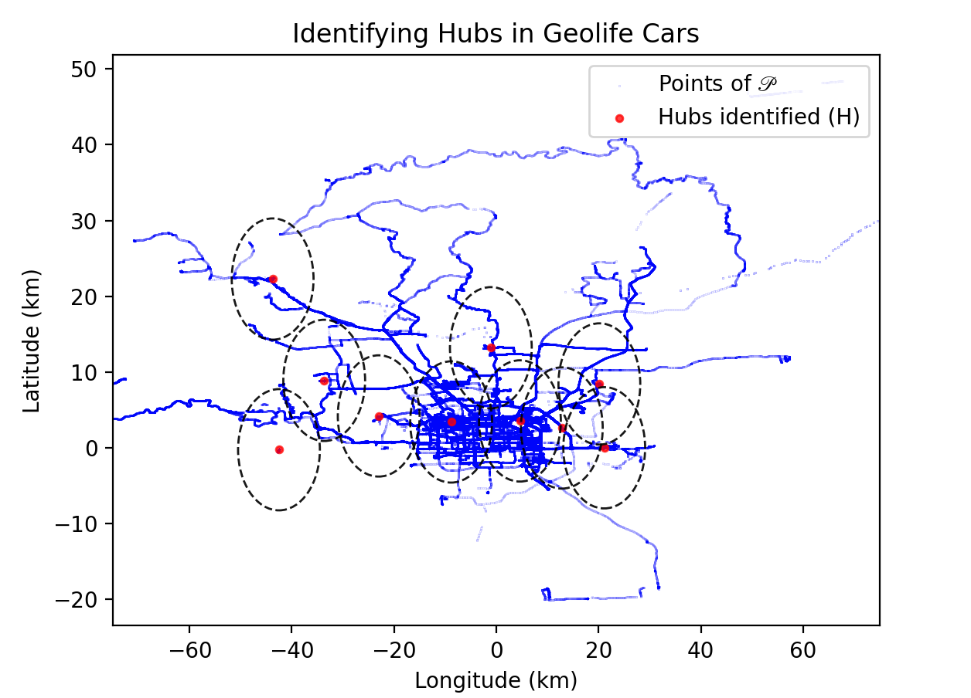
Task 1: Identifying the Hubs
Results
GeoLife Car density hubs when k = 10 and r = 8 km
Hubs: [(-8.836427, 3.418779), (4.618459, 3.554283), (21.107819, 0.011147), (-42.511082, -0.247037), (-1.07216, 13.210553), (-43.748955, 22.274824), (-23.003753, 4.212144), (-33.662756, 8.90505), (20.153817, 8.432032), (12.809367, 2.625083)]

Slide 8
Task 1: Identifying the Hubs
Advantages, Drawbacks, and Future Scope for Hubs
Advantages:
Relatively quick to compute, given density() runs in O(1)
Utilizes a greedy approach to select the point with the greatest density on each iteration
Drawbacks:
Only looks at hubs within the set of points P
Does not consider combining density counts between multiple matrix cells
Greedy approach does not find maximal sum of densities
Future Scope for Enhancement:
Able to select points that are not within the set of points P
Find hubs that maximize the sum of the densities

Slide 9
Task 2: Trajectory Simplification
Trajectory Simplification Algorithm
Recursive Greedy Algorithm:
For a trajectory with n points and an error parameter of ε, we start by finding the largest point that has a distance larger than ε from the line that runs between 1 and n. This means that the point is outside the designated error margin.
If such a value, m, is found, we recurse through the left and right sides of this point, with m being the new end point for the left side, and the new start point for the right. We include this point m in the final simplified trajectory.
If an m value is not found, we have found the most simplified version of the path and no points other than the start and end points will be included in the final simplified trajectory.
Average running time: O(nlogn) because the maximum point found when dividing the trajectory will most often fall between ¼ and ¾ of the points on the trajectory. Similar to quicksort, this results in an average running time of O(nlogn).

Slide 10
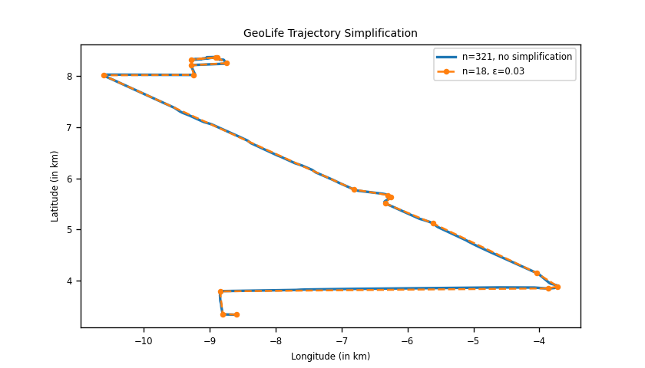

Slide 11
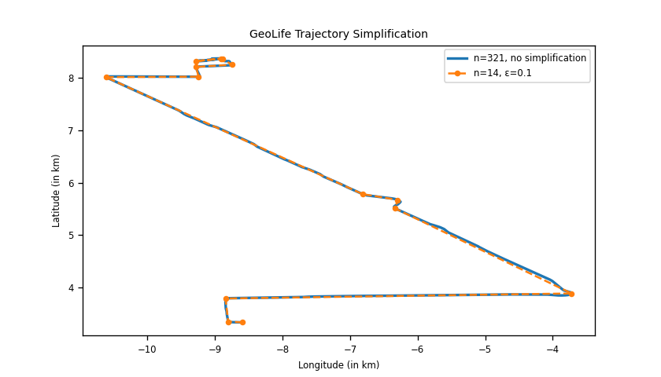

Slide 12
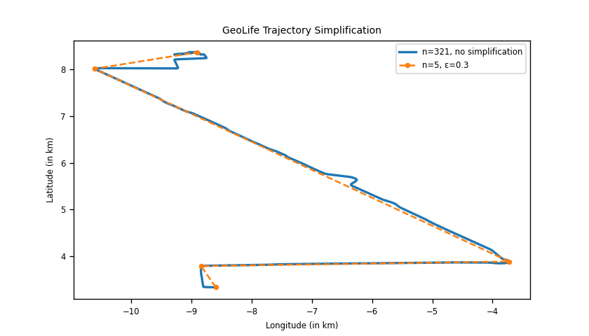

Slide 13
Task 2: Trajectory Simplification
Compression Ratios
Trajectories (ε = 0.03km) | |T| (original) | |T’| (simplified) | |T|/|T’|
128-20080503104400 | 321 | 18 | 17.83
010-20081016113953 | 543 | 11 | 49.36
115-20080520225850 | 1330 | 37 | 35.95
115-20080615225707 | 1442 | 38 | 37.95

Slide 14
Task 2: Trajectory Simplification
Advantages, Drawbacks, and Future Scope
Advantages:
Greedy algorithm; does not reprocess any points – relatively efficient for real-world use
Simple to explain and implement
Preserves start and end points of original path
Drawbacks:
Is not always guaranteed to be the most optimal solution
Loss of curvature and detail from the original path
Often does not retain features of paths with irregular shapes, sharp turns, loops, etc.
Future Scope for Enhancement:
Improve performance using data structures (dynamic convex hull) or modifying the algorithm to reach a linear running time
Improve path detail retention

Slide 15

Task 3: Comparing Trajectories
Distance Algorithm - Dynamic Time Warping (DTW)
Recurrence relation
Algorithm
Create n x m matrix where n is the |first trajectory| and m is the |second trajectory|
Initialize all matrix values to 10,000,000, but set matrix[0][0] = 0
Use a nested for-loop to traverse the matrix and execute the following on each iteration:
Compute the squared distance between the given points in trajectory #1 and trajectory #2
Find the minimum between matrix[i-1][j], matrix[i][j-1], matrix[i-1][j-1]
Set matrix[i][j] as the sum of these two values
Runtime
O(nm) where n is the |first trajectory| and m is the |second trajectory|. This algorithm consists of a nested for-loop that iterates over all indices in the matrix, which is of size n x m, and merely carries out arithmetic operations on each iteration.
Space Complexity:
O(nm). The n x m matrix is used to store the sub-problem solutions.

Slide 16
Task 3: Comparing Trajectories
Distance Algorithm - Frechet Distance
Recurrence relation
Algorithm
Create n x m matrix where n is the |first trajectory| and m is the |second trajectory|
Initialize all matrix values to 10,000,000, but set matrix[0][0] = 0
Use a nested for-loop to traverse the matrix and execute the following on each iteration:
Compute the distance between the given points in trajectory #1 and trajectory #2
Find the minimum between matrix[i-1][j], matrix[i][j-1], matrix[i-1][j-1]
Set matrix[i][j] as the max of those two values
Runtime
O(nm) where n is the |first trajectory| and m is the |second trajectory|. This algorithm consists of a nested for-loop that iterates over all indices in the matrix, which is of size n x m.
Space Complexity:
O(nm). The n x m matrix is used to store the sub-problem solutions.

Slide 17
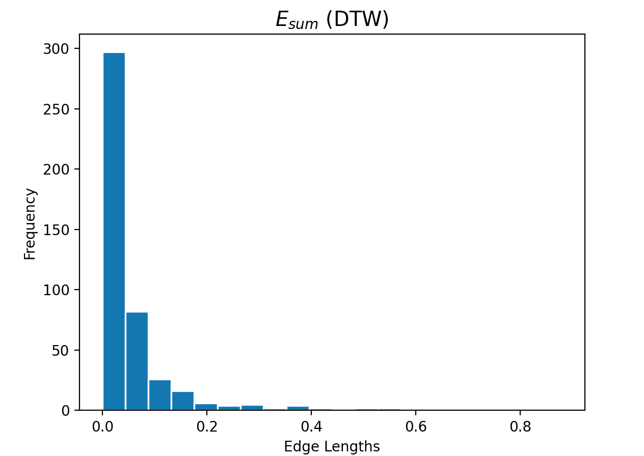
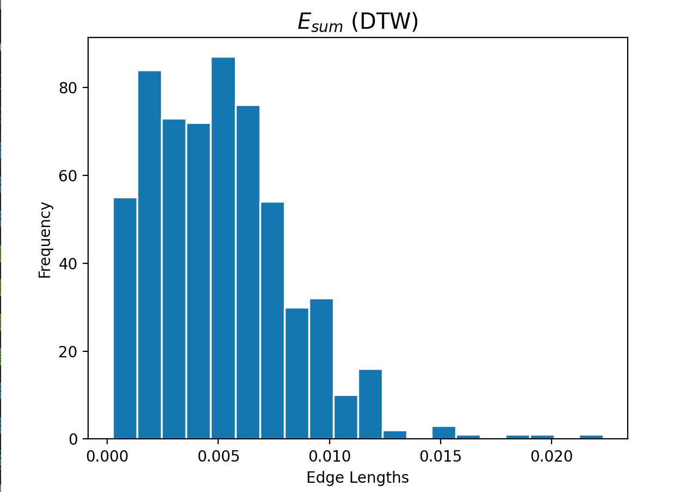
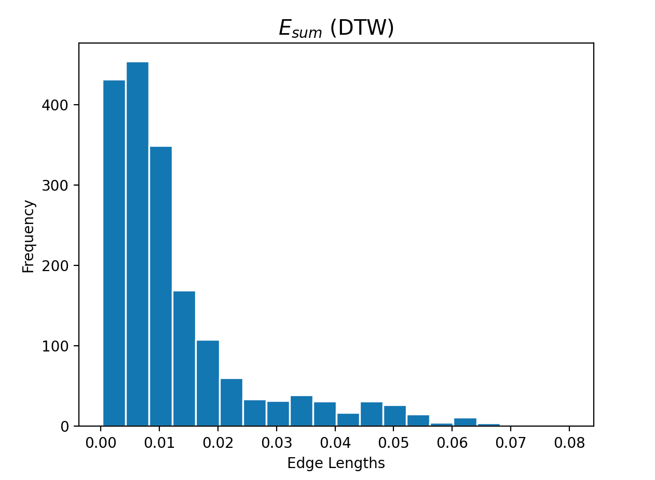
Task 3: Comparing Trajectories
DTW Results
Trajectory #1: 128-20080503104400
Trajectory #2: 128-20080509135846
Trajectory #3: 010-20081016113953, Trajectory #4: 010-20080923124453
Trajectory #5: 115-20080520225850, Trajectory #6: 115-20080615225707
DTW Distance: 0.013385545547278787
Length of Path: 452
DTW Distance: 3.5891074458194065e-05
Length of Path: 598
DTW Distance: 0.00033030857599725415
Length of Path: 1821

Slide 18
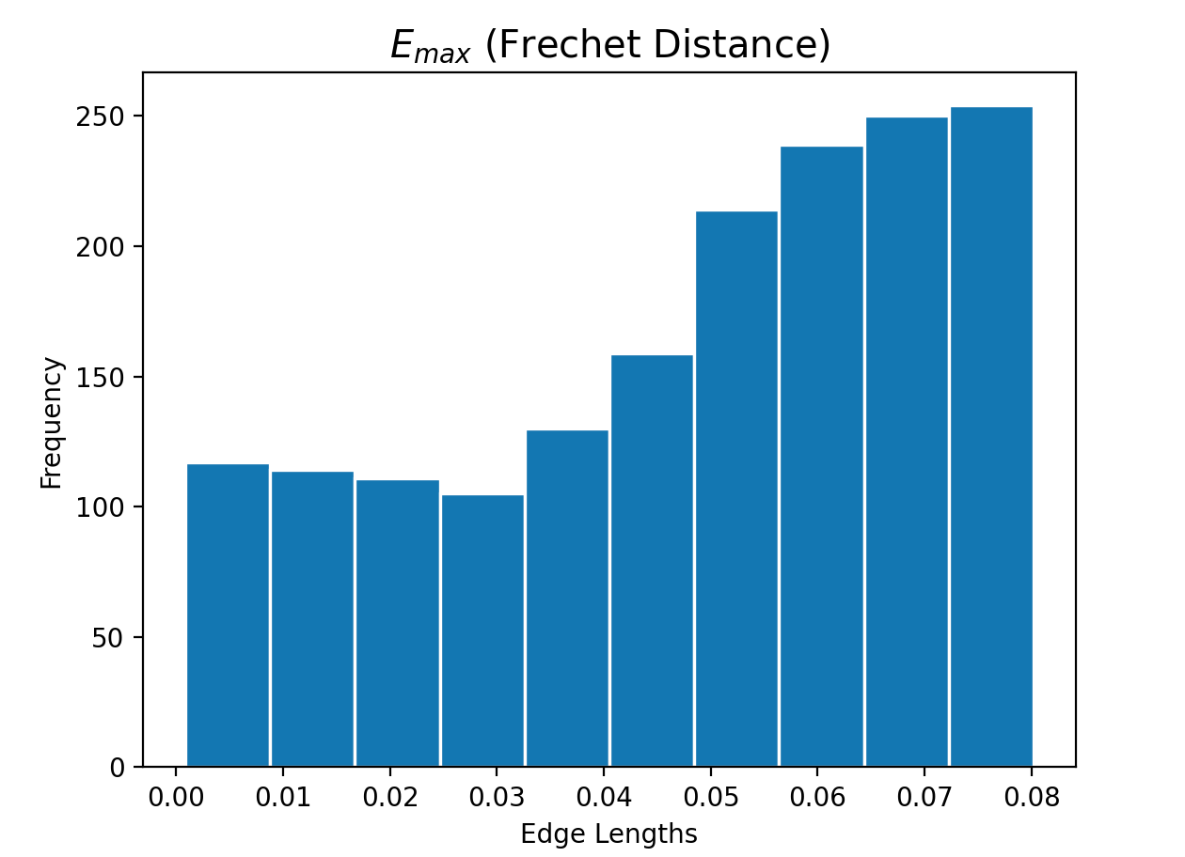
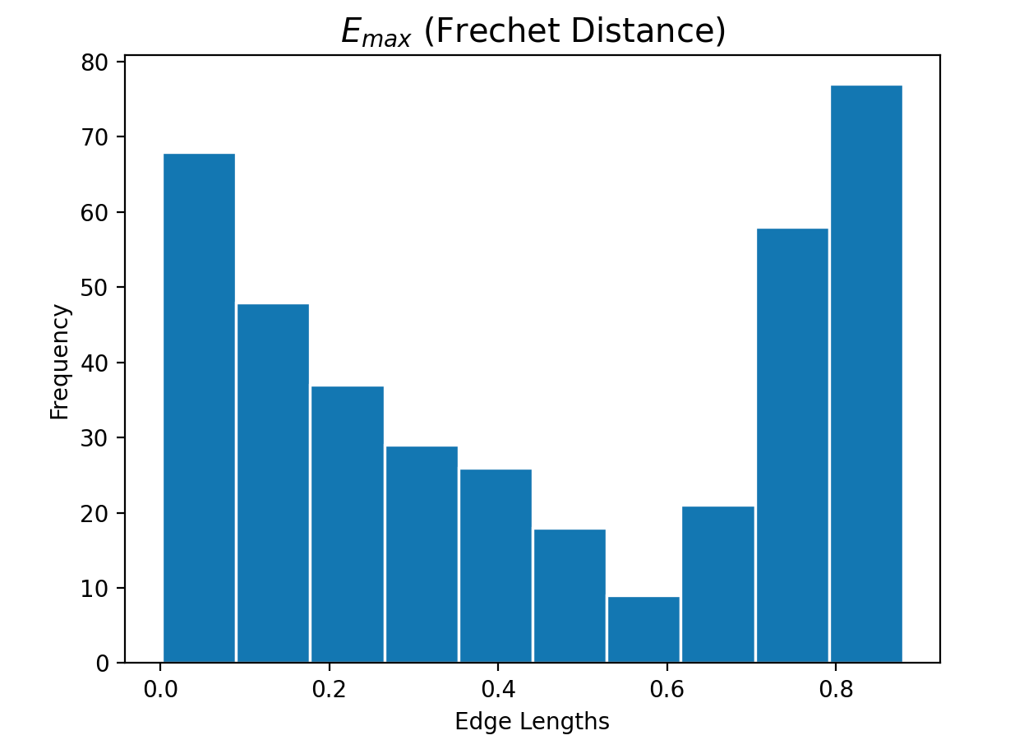
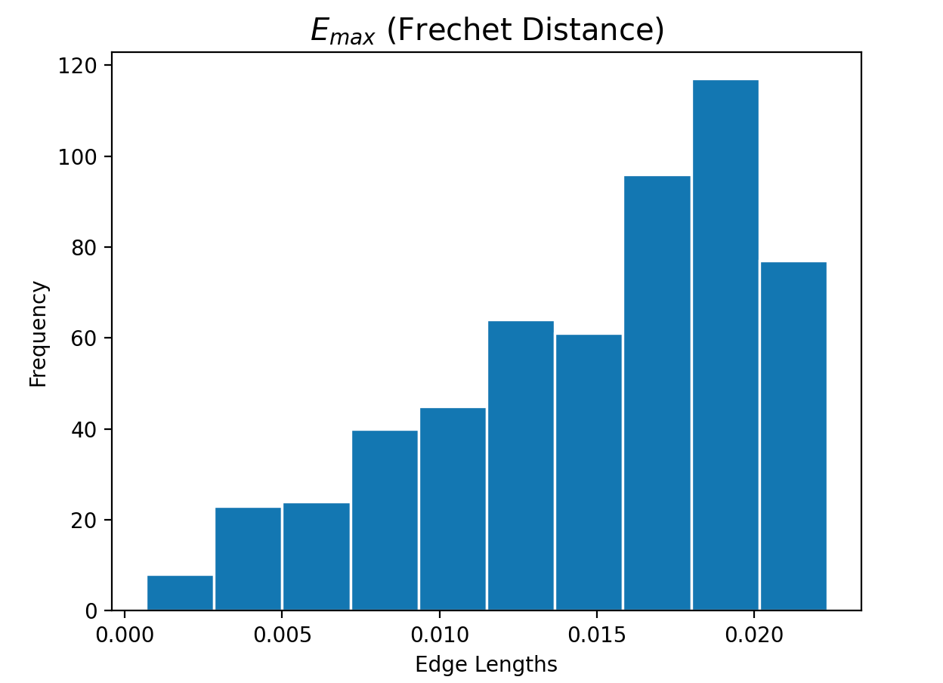
Task 3: Comparing Trajectories
Frechet Results
Trajectory #1: 128-20080503104400
Trajectory #2: 128-20080509135846
Trajectory #3: 010-20081016113953, Trajectory #4: 010-20080923124453
Trajectory #5: 115-20080520225850, Trajectory #6: 115-20080615225707
Frechet Distance: 0.8796899541048543
Length of Path: 391
Frechet Distance: 0.02232791537515335
Length of Path: 555
Frechet Distance: 0.08019256605197136
Length of Path: 1693

Slide 19
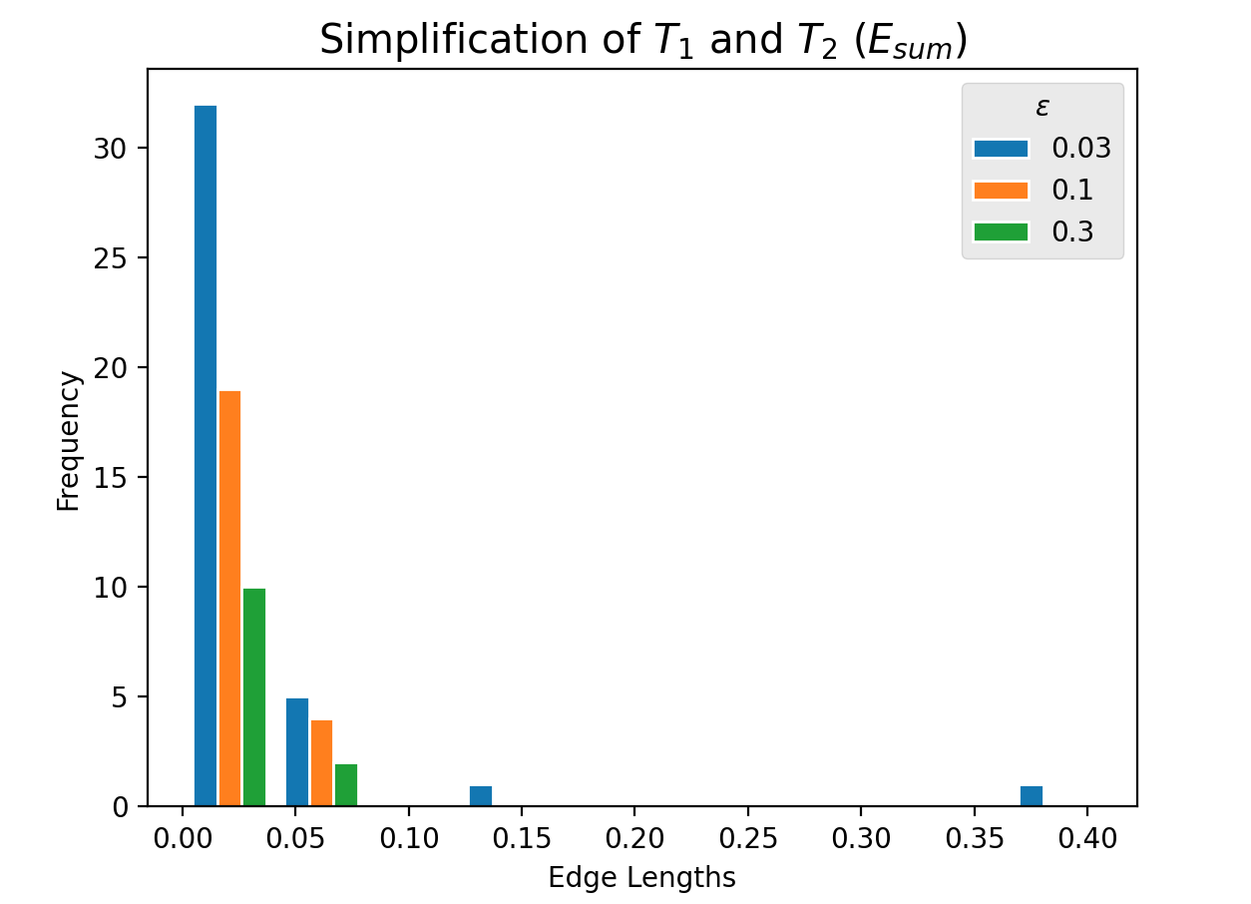
Task 3: Comparing Trajectories
Simplification Results
T1: 115-20080520225850
T2: 115-20080615225707
ε = 0.03 km
Distance: 0.21281616522699964
Path Length: 39
ε = 0.1 km
Distance: 0.022767151829999725
Path Length: 23
ε = 0.3 km
Distance:0.01063974558099992
Path Length: 12

Slide 20
Task 3: Comparing Trajectories
Advantages and Drawbacks
Advantages:
DTW
Minimizes the summed squared distance between matched vertices in two trajectories
Less sensitive to outliers
Frechet Distance
Computes the minimal maximum distance between a point on one trajectory and its counterpart on another
Drawbacks:
DTW
Sensitive to the relative sampling rates of the trajectories, given the edges between vertices in a trajectory are ignored
Frechet Distance
Sensitive to outliers in the trajectory data

Slide 21
Group Member Contributions
Kylie
Designed density() and hubs() algorithms, adjusted dtw() from HW 4 and wrote fd(), created related slides
May
Created scatter plot and histogram visualizations for Task 1 and 3, wrote function to parse through data, created related slides
Grace
Designed and implemented function d(q,e), created Task 2 visualizations, created related slides
Elise
Designed and implemented TS-Greedy algorithm, created related slides

